Slide 1
Linear Regression
Abhijit Dutt

Slide 2
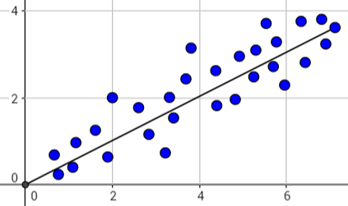
Simple Linear Regression Statistical Relationship Between Variables
Statistical relationships between variables have two components
A functional relationship which represents the expected value of the response variable (Y) given the predictor variable (X), usually denoted by E(Y|X = x)
A random component. This represents random deviations from the functional relationship
The following graph displays a linear statistical relationship between two variables:

Slide 3
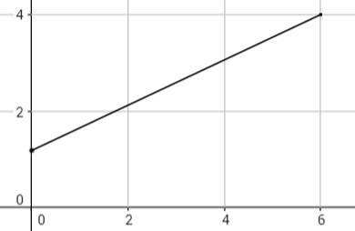
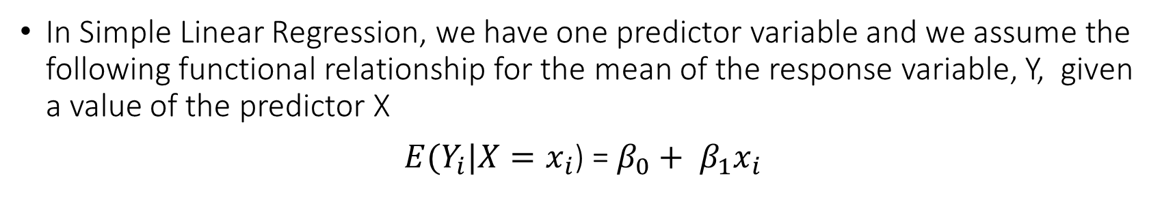
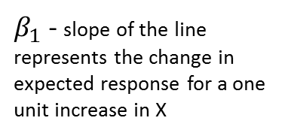
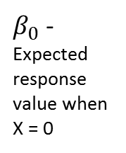
Simple Linear Regression The Functional Component
In Simple Linear Regression, we have one predictor variable and we assume the following functional relationship for the mean of the response variable, Y, given a value of the predictor X
$E(Y_{i}|X=x_{i}$) = $β_{0}+ β_{1}x_{i}$
$β_{1}$ - slope of the line represents the change in expected response for a one unit increase in X
$β_{0}$ - Expected response value when X = 0
{

Slide 4
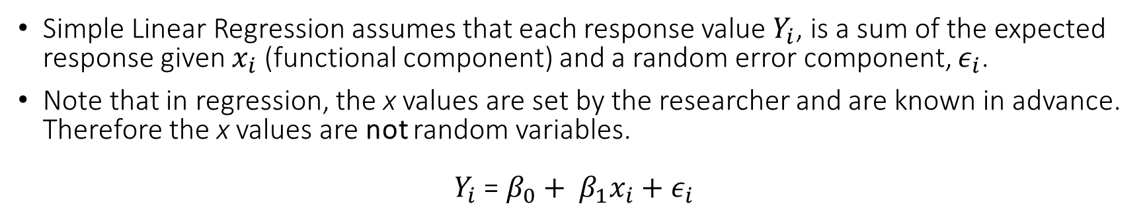
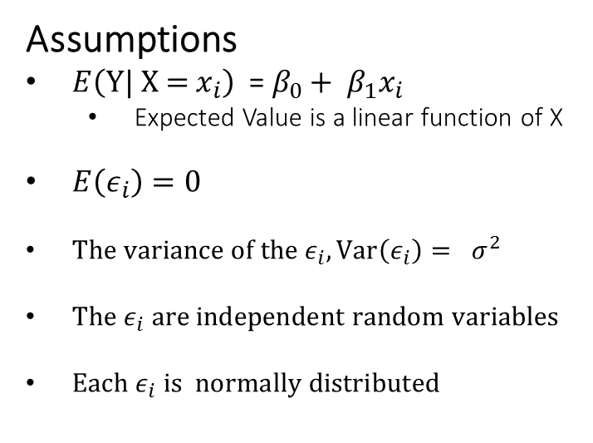
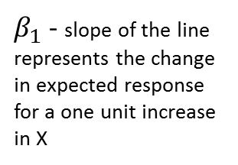
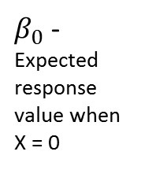
Simple Linear Regression Adding the Random Component
Simple Linear Regression assumes that each response value $Y_{i}$, is a sum of the expected response given $x_{i}$ (functional component) and a random error component, $ε_{i}$.
Note that in regression, the x values are set by the researcher and are known in advance. Therefore the x values are not random variables.
$Y_{i}$ = $β_{0}+ β_{1}x_{i}+ε_{i}$
Assumptions
$E\left(\text{Y}\text{| }\text{X}\text{ = }x_{i}\right) \text{= }β_{0}+ β_{1}x_{i}$
Expected Value is a linear function of X
$E\left(ε_{i}\right)=0$
$The variance of the ε_{i}, Var\left(ε_{i}\right)= σ^{2}$
$The ε_{i} are independent random variables$
$Each ε_{i} is normally distributed$
$β_{1}$ - slope of the line represents the change in expected response for a one unit increase in X
$β_{0}$ - Expected response value when X = 0
{

Slide 5
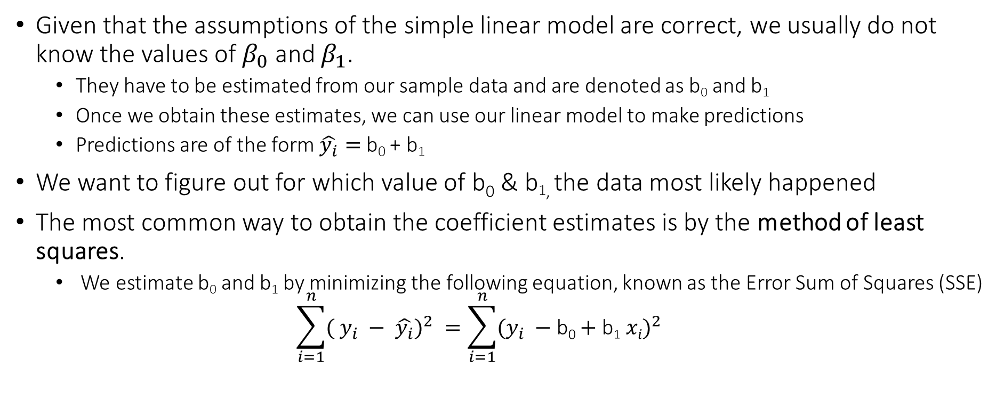
Simple Linear Regression Estimating the Coefficients
Given that the assumptions of the simple linear model are correct, we usually do not know the values of $β_{0}$ and $β_{1}$.
They have to be estimated from our sample data and are denoted as b₀ and b₁
Once we obtain these estimates, we can use our linear model to make predictions
Predictions are of the form $\hat{y_{i}}=$ b₀ + b₁
We want to figure out for which value of b₀ & b_{1,} the data most likely happened
The most common way to obtain the coefficient estimates is by the method of least squares.
We estimate b₀ and b₁ by minimizing the following equation, known as the Error Sum of Squares (SSE)
$$\sum_{i=1}^{n}{({ y_{i} − \hat{y_{i}})}^{2}} =\sum_{i=1}^{n}{({y_{i} −\text{b}\text{0}+\text{b}\text{1} xi)}^{2}}$$

Slide 6
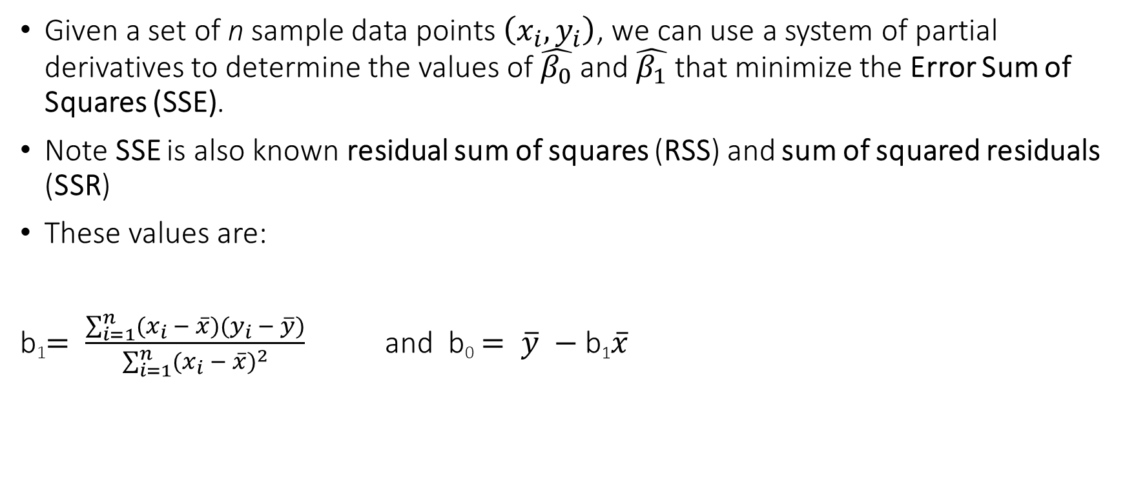
Simple Linear Regression Estimating the Coefficients
Given a set of n sample data points $\left(x_{i}, y_{i}\right)$, we can use a system of partial derivatives to determine the values of $\hat{β_{0}}$ and $\hat{β_{1}}$ that minimize the Error Sum of Squares (SSE).
Note SSE is also known residual sum of squares (RSS) and sum of squared residuals (SSR)
These values are:
b₁$= \frac{\sum_{i=1}^{n}{(x_{i} − \overline{x})(y_{i} − \overline{y})}}{\sum_{i=1}^{n}{{(x_{i} − \overline{x})}^{2}}}$ and b₀ $= \overline{y} −\text{b}\text{1}\overline{x}$

Slide 7
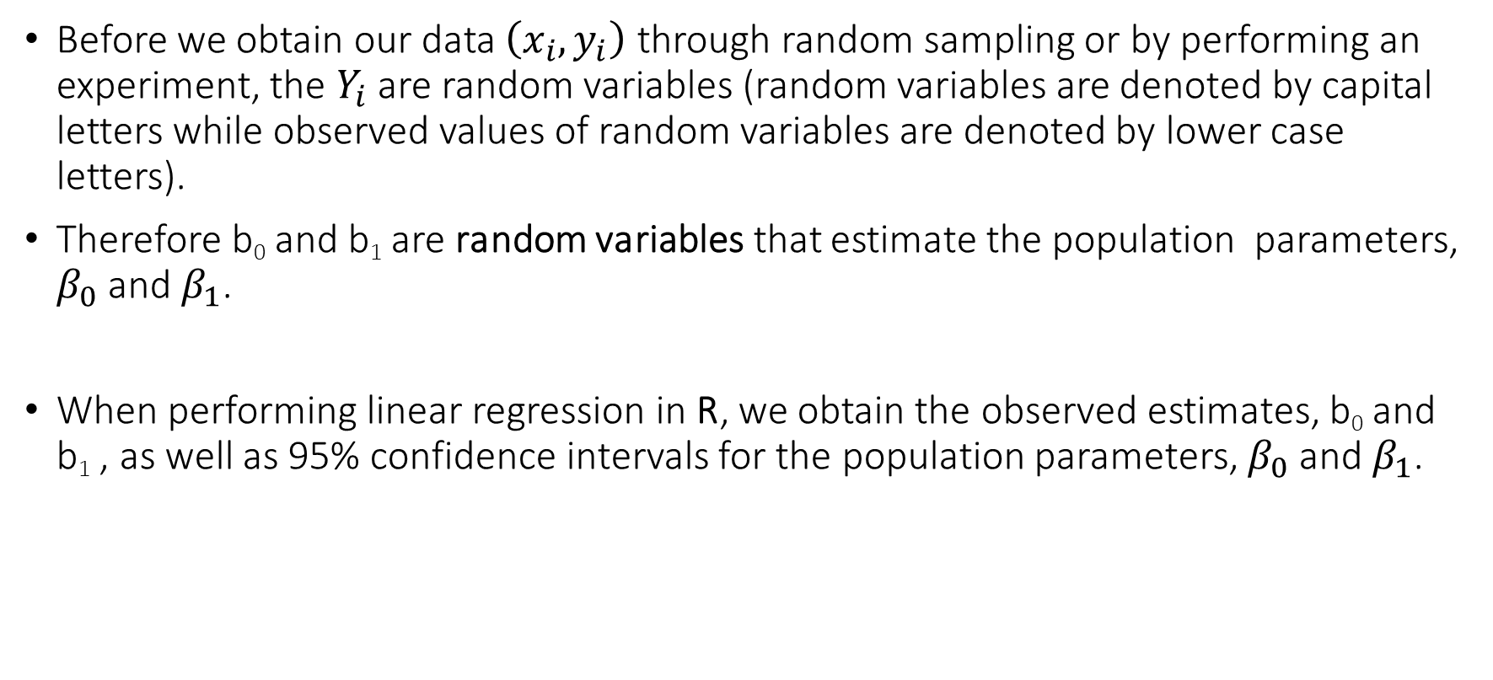
Simple Linear Regression Accuracy of the Coefficients
Before we obtain our data $\left(x_{i}, y_{i}\right)$ through random sampling or by performing an experiment, the $Y_{i}$ are random variables (random variables are denoted by capital letters while observed values of random variables are denoted by lower case letters).
Therefore b₀ and b₁ are random variables that estimate the population parameters, $β_{0}$ and $β_{1}$.
When performing linear regression in R, we obtain the observed estimates, b₀ and b₁ , as well as 95% confidence intervals for the population parameters, $β_{0}$ and $β_{1}$.

Slide 8
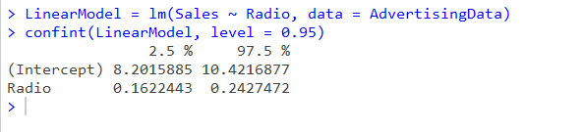
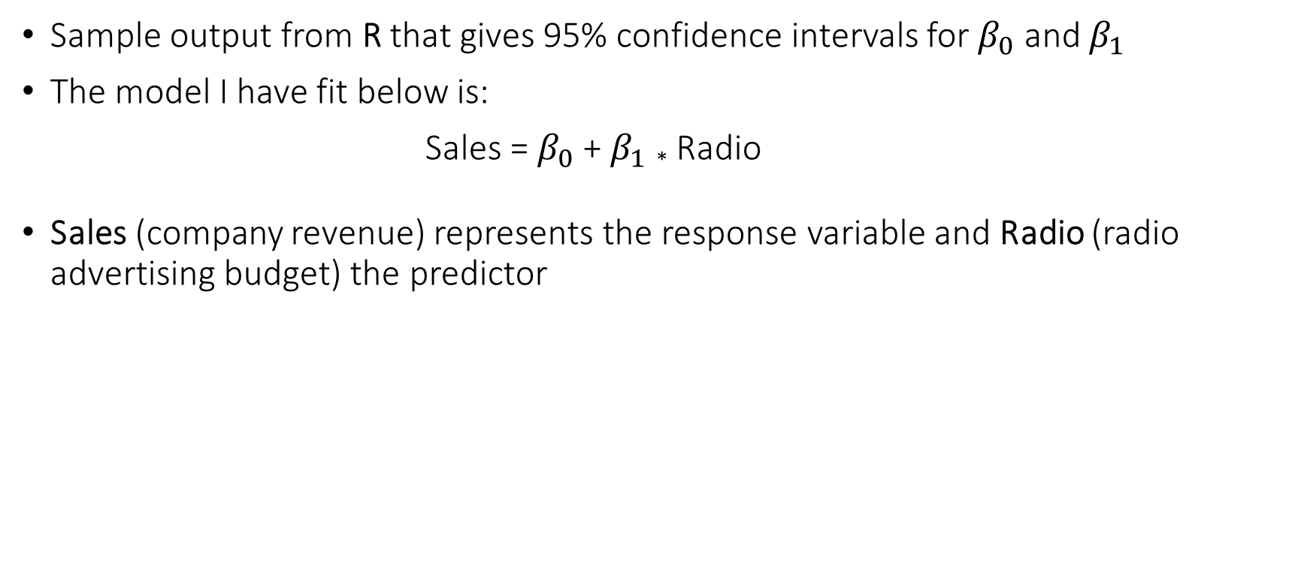
Simple Linear Regression Accuracy of the Coefficients
Sample output from R that gives 95% confidence intervals for $β_{0}$ and $β_{1}$
The model I have fit below is:
Sales = $β_{0}$ + $β_{1}$ * Radio
Sales (company revenue) represents the response variable and Radio (radio advertising budget) the predictor

Slide 9
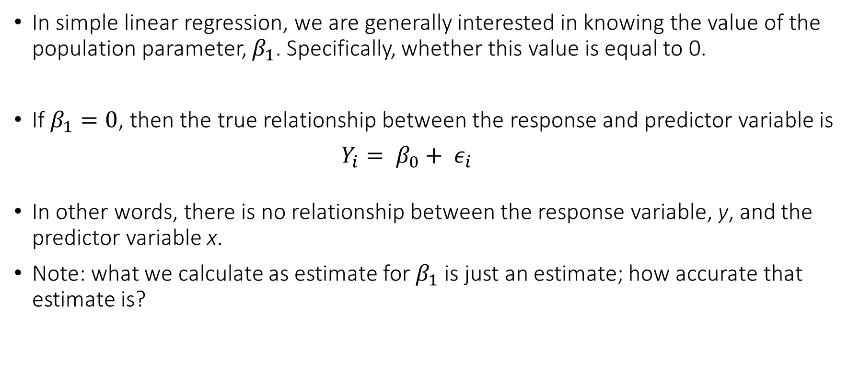
Simple Linear Regression Hypothesis Testing in Simple Linear Regression
In simple linear regression, we are generally interested in knowing the value of the population parameter, $β_{1}$. Specifically, whether this value is equal to 0.
If $β_{1}=0$, then the true relationship between the response and predictor variable is
$Y_{i}= β_{0}+ ε_{i}$
In other words, there is no relationship between the response variable, y, and the predictor variable x.
Note: what we calculate as estimate for $β_{1}$ is just an estimate; how accurate that estimate is?

Slide 10
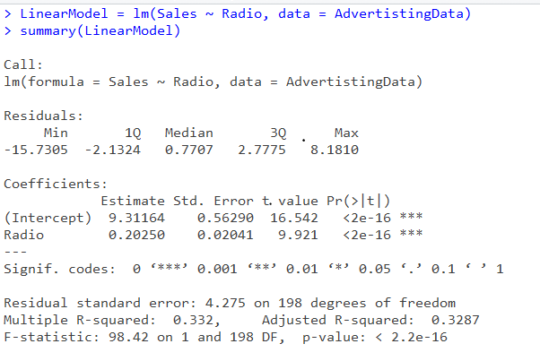
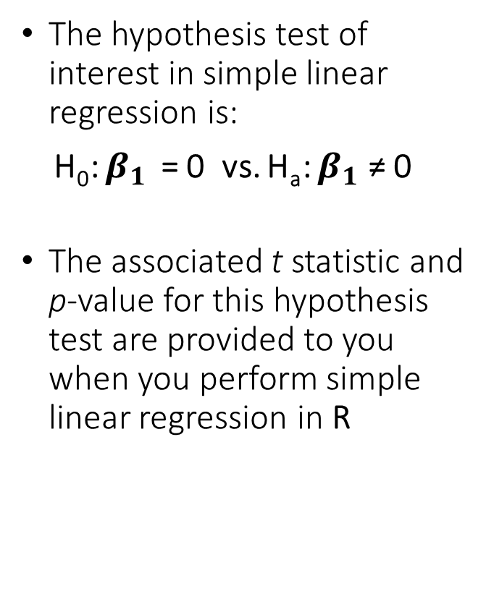
Simple Linear Regression Hypothesis Testing in Simple Linear Regression
The hypothesis test of interest in simple linear regression is:
H₀: $β_{1}$ = 0 vs. H_{a}: $β_{1}$ ≠ 0
The associated t statistic and p-value for this hypothesis test are provided to you when you perform simple linear regression in R

Slide 11
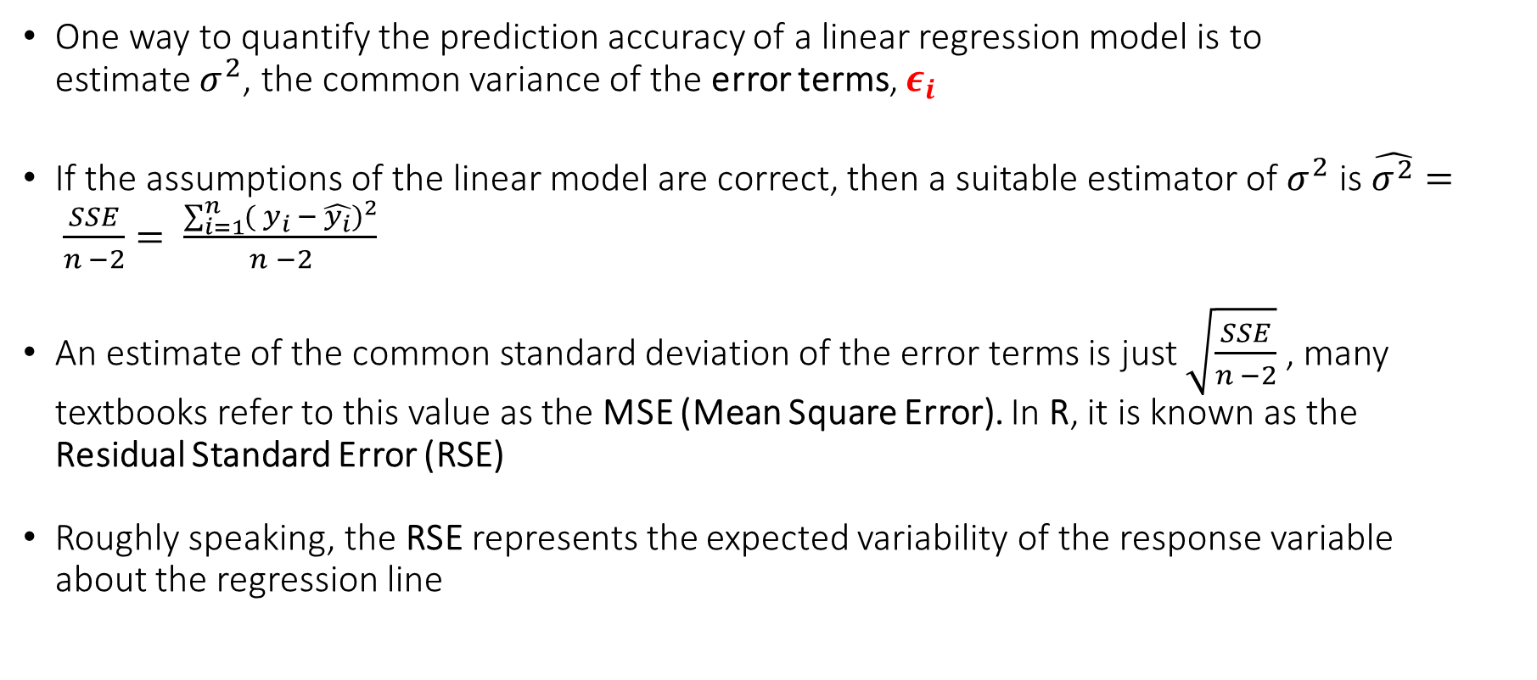
Simple Linear Regression Assessing the Quality of a Regression Model: Residual Standard Error
One way to quantify the prediction accuracy of a linear regression model is to estimate $σ^{2}$, the common variance of the error terms, $ε_{i}$
If the assumptions of the linear model are correct, then a suitable estimator of $σ^{2}$ is $\hat{σ^{2}}= \frac{SSE}{n −2}= \frac{\sum_{i=1}^{n}{({ y_{i} − \hat{y_{i}})}^{2}}}{n −2}$
An estimate of the common standard deviation of the error terms is just $\sqrt{\frac{SSE}{n −2}}$ , many textbooks refer to this value as the MSE (Mean Square Error). In R, it is known as the Residual Standard Error (RSE)
Roughly speaking, the RSE represents the expected variability of the response variable about the regression line

Slide 12
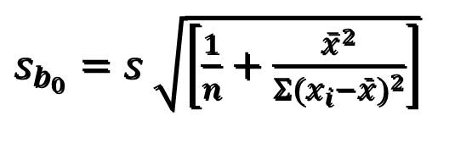
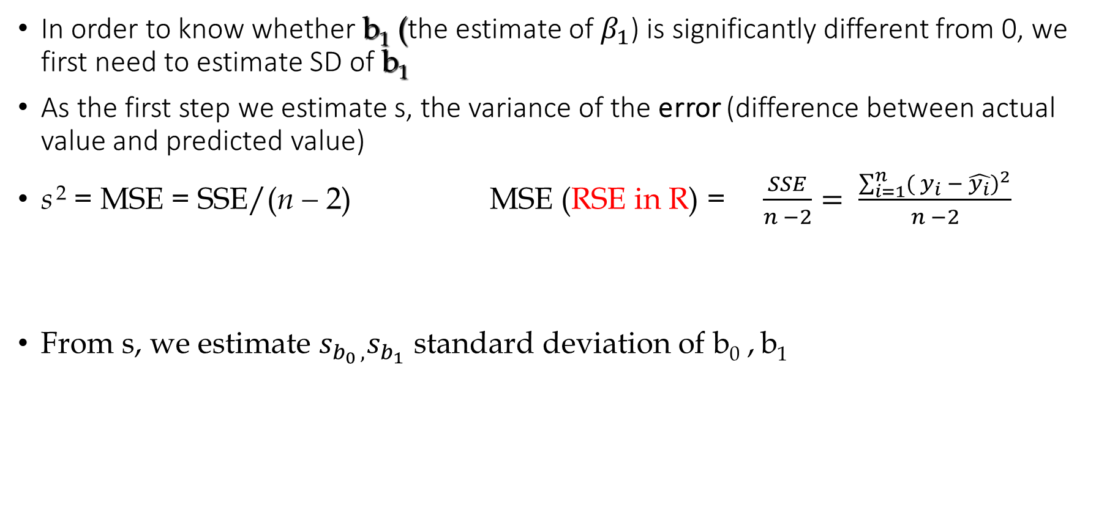

Estimation
In order to know whether b₁ (the estimate of $β_{1}$) is significantly different from 0, we first need to estimate SD of b₁
As the first step we estimate s, the variance of the error (difference between actual value and predicted value)
s ² = MSE = SSE/(n − 2) MSE (RSE in R) = $\frac{SSE}{n −2}= \frac{\sum_{i=1}^{n}{({ y_{i} − \hat{y_{i}})}^{2}}}{n −2}$
From s, we estimate ${s_{b_{0 },}s}_{b_{1}}$ standard deviation of b₀ , b₁
$$s_{b_{1}}=\frac{s}{\sqrt{Σ(x_{i}−\bar{x})^{2}}}$$
$s_{b_{0}}=s$ $\sqrt{\left[\frac{1}{n}+\frac{{\overline{x}}^{2}}{Σ(x_{i}−\bar{x})^{2}}\right]}$

Slide 13
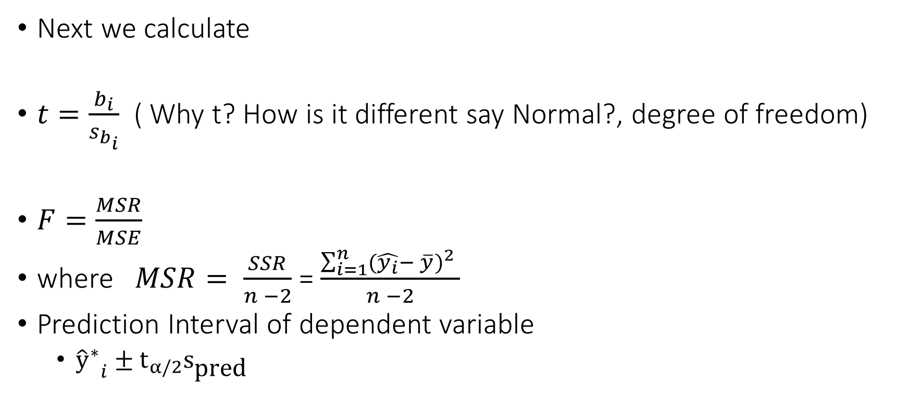
Estimation (Continued)
Next we calculate
$t=\frac{b_{i}}{s_{b_{i}}}$ ( Why t? How is it different say Normal?, degree of freedom)
$F=\frac{MSR}{MSE}$
where $MSR= \frac{SSR}{n −2}$= $\frac{\sum_{i=1}^{n}{{(\hat{y_{i}}− \overline{y})}^{2} }}{n −2}$
Prediction Interval of dependent variable
${{\hat{y}}^{∗}}_{i}±t_{α/2}s_{\text{pred}}$

Slide 14

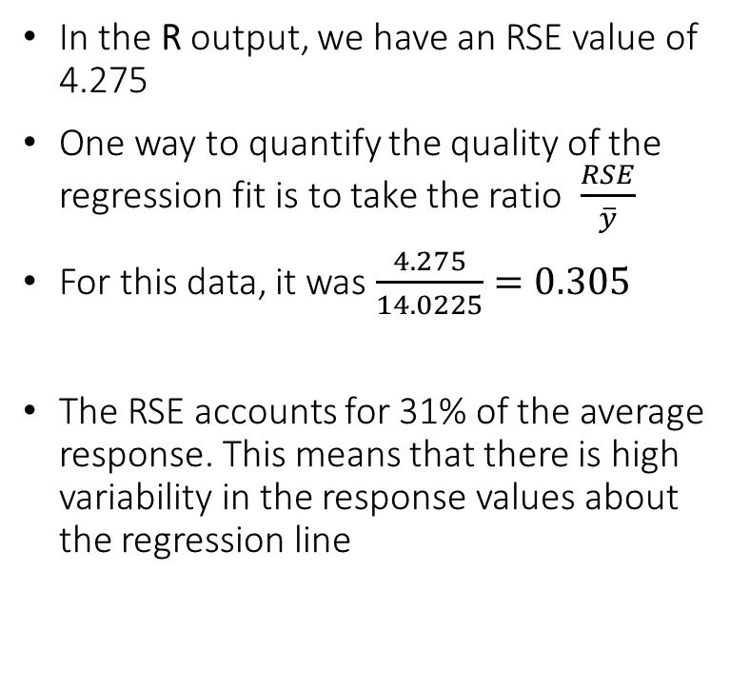
Simple Linear Regression Assessing the Quality of a Regression Model: Residual Standard Error
In the R output, we have an RSE value of 4.275
One way to quantify the quality of the regression fit is to take the ratio $\frac{RSE}{\overline{y}}$
For this data, it was $\frac{4.275}{14.0225}=0.305$
The RSE accounts for 31% of the average response. This means that there is high variability in the response values about the regression line

Slide 15

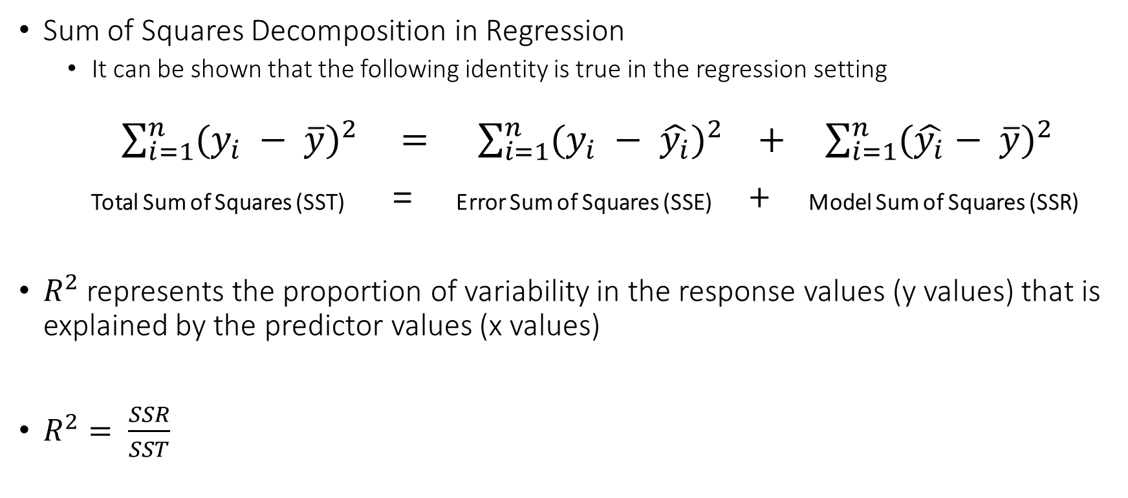
Simple Linear Regression Assessing the Quality of a Regression Model: $R^{2}$
Sum of Squares Decomposition in Regression
It can be shown that the following identity is true in the regression setting
$\sum_{i=1}^{n}{{(y_{i} − \overline{y})}^{2} = }$ $\sum_{i=1}^{n}{{(y_{i} − \hat{y_{i}})}^{2} + \sum_{i=1}^{n}{{(\hat{y_{i}}− \overline{y})}^{2} }}$
Total Sum of Squares (SST) = Error Sum of Squares (SSE) + Model Sum of Squares (SSR)
$R^{2}$ represents the proportion of variability in the response values (y values) that is explained by the predictor values (x values)
$R^{2}= \frac{SSR}{SST}$

Slide 16
Simple Linear Regression Confidence Interval for the Mean Value of Y Given X = x
We can use R to obtain a point estimate and a 95% confidence interval for the population mean value of Y (response) given a predictor value of x.
In the example below, I am obtaining the estimated mean and 95% confidence interval for the mean of Sales given that Radio = 40.2

Slide 17
Simple Linear Regression Confidence Interval for an Individual Value of Y Given X = x
We can also use R to obtain a point estimate and a 95% confidence interval for an individual value of Y (response) given a predictor value of x.
In the example below, I am obtaining the estimated mean and 95% confidence interval for an individual value of Sales given that Radio = 40.2

